Slide 1
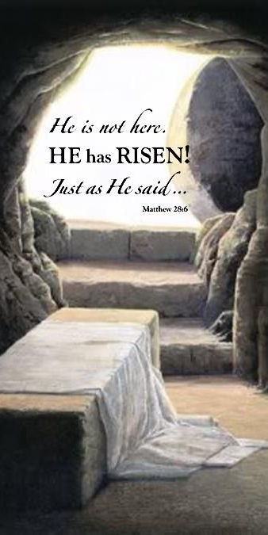
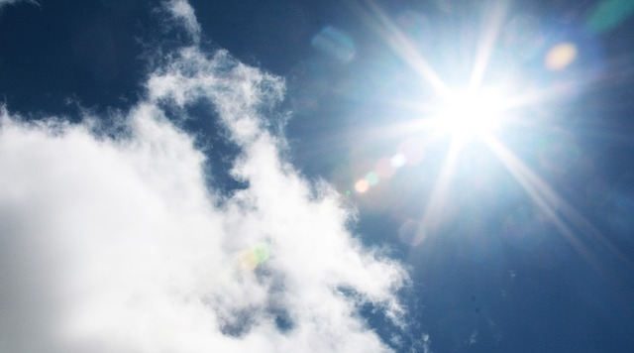
Seven Proofs of the Resurrected Christ!
(The Power of the Gospel: Bring it Home!)

Slide 2
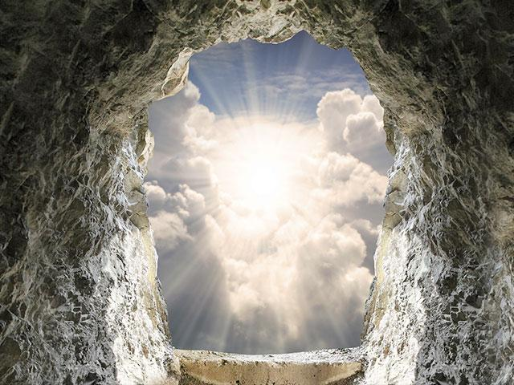
Introduction:
Romans 1:16
I Corinthians 15:3,4
What is the Power of God to salvation?
The Gospel of Jesus Christ!

Slide 3
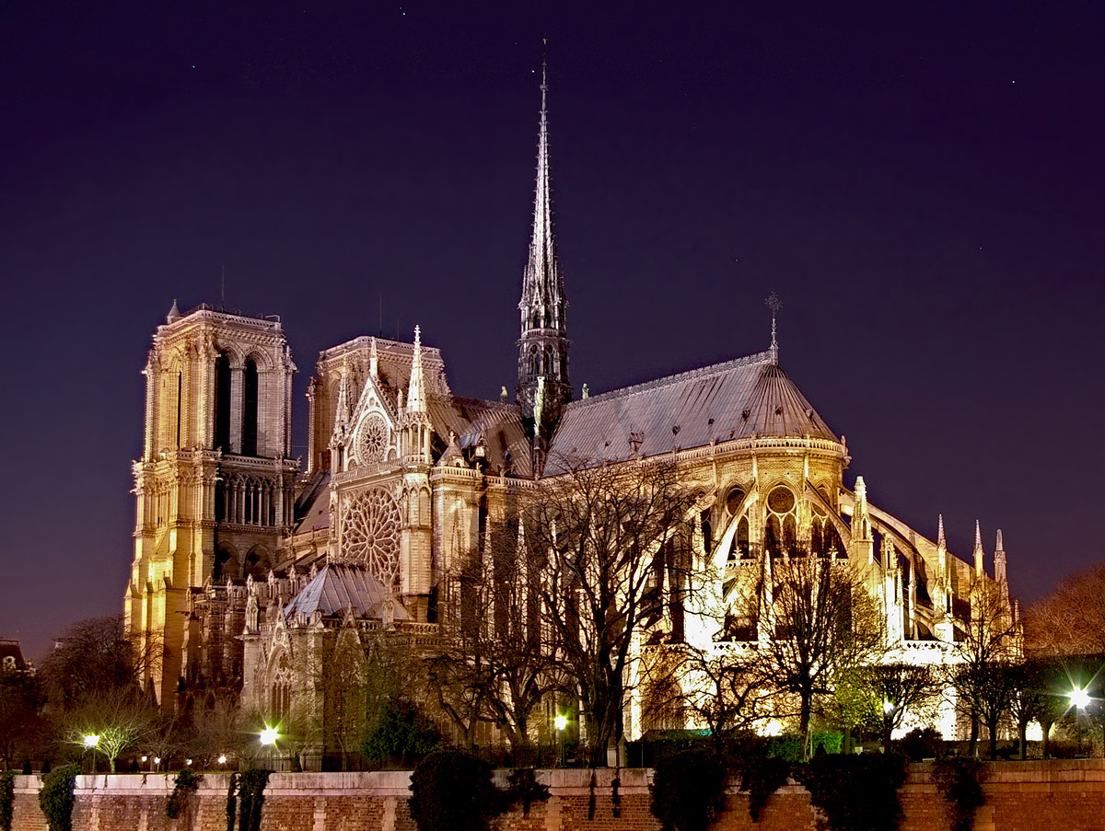

Slide 4
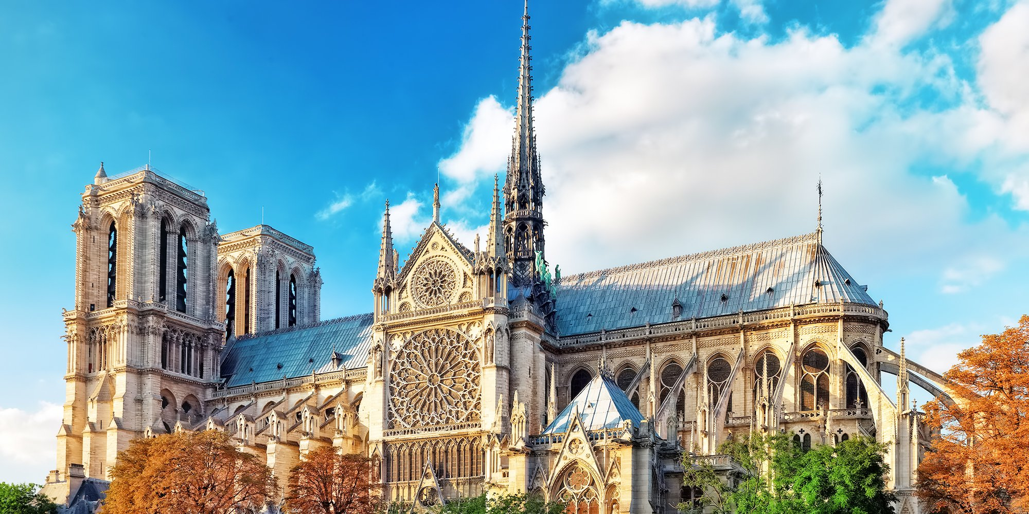

Slide 5
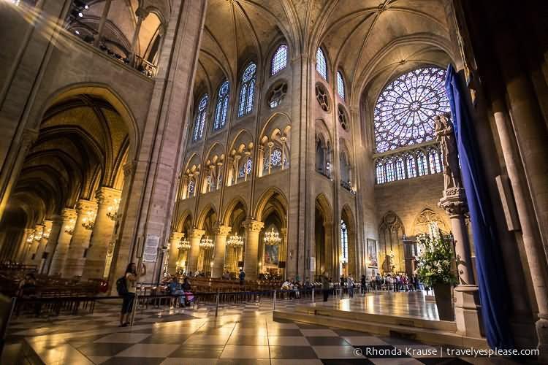

Slide 6
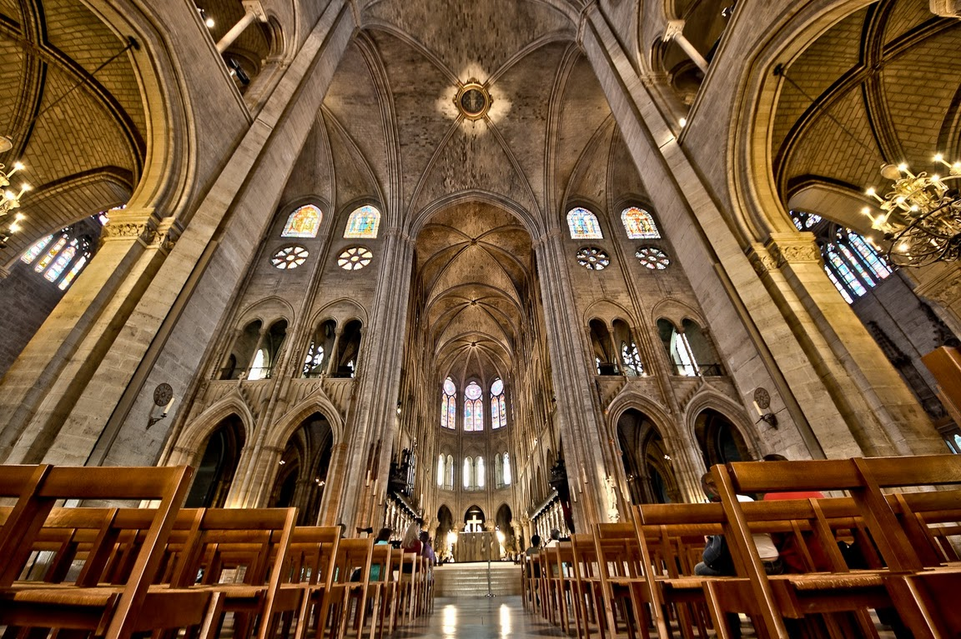

Slide 7
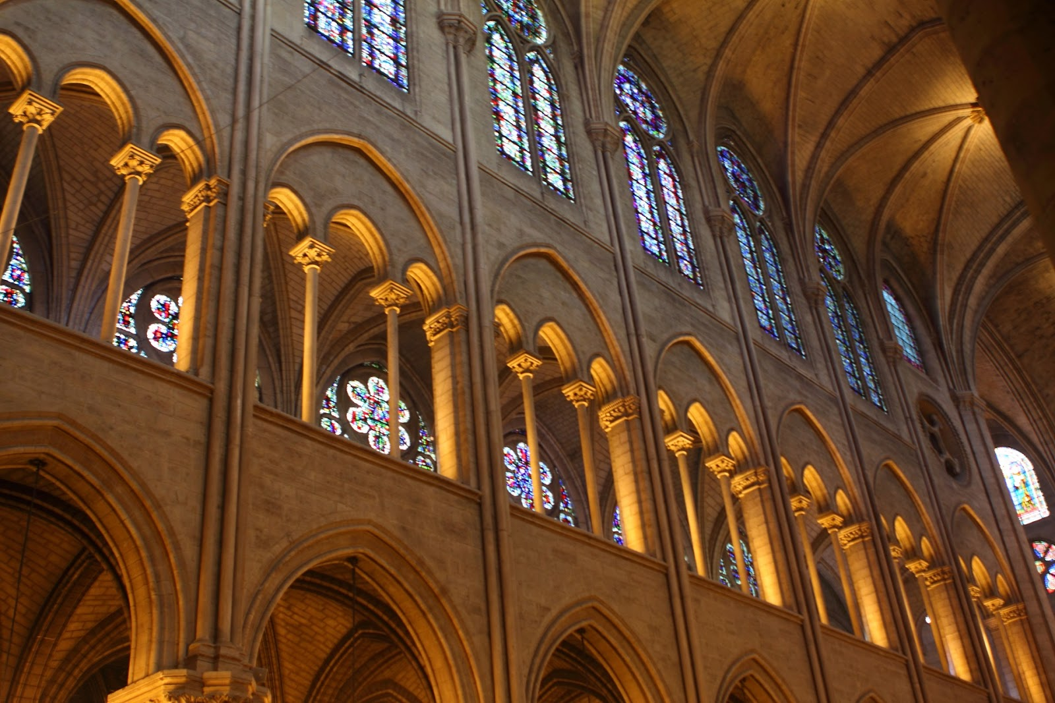

Slide 8
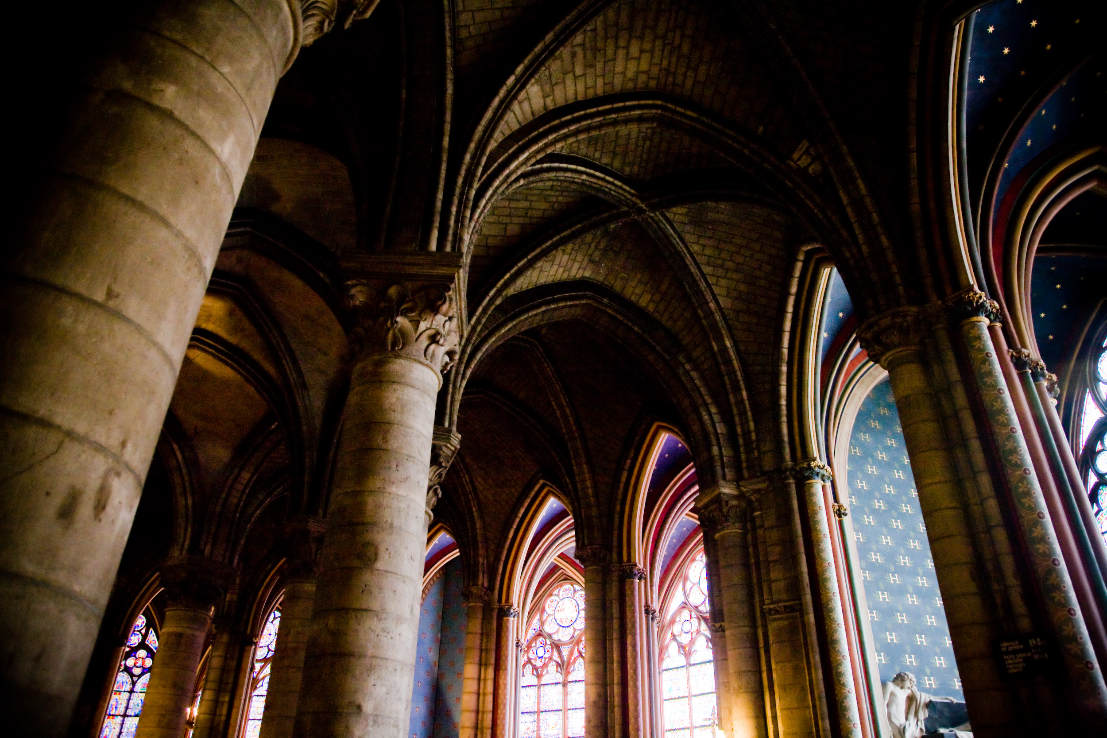

Slide 9
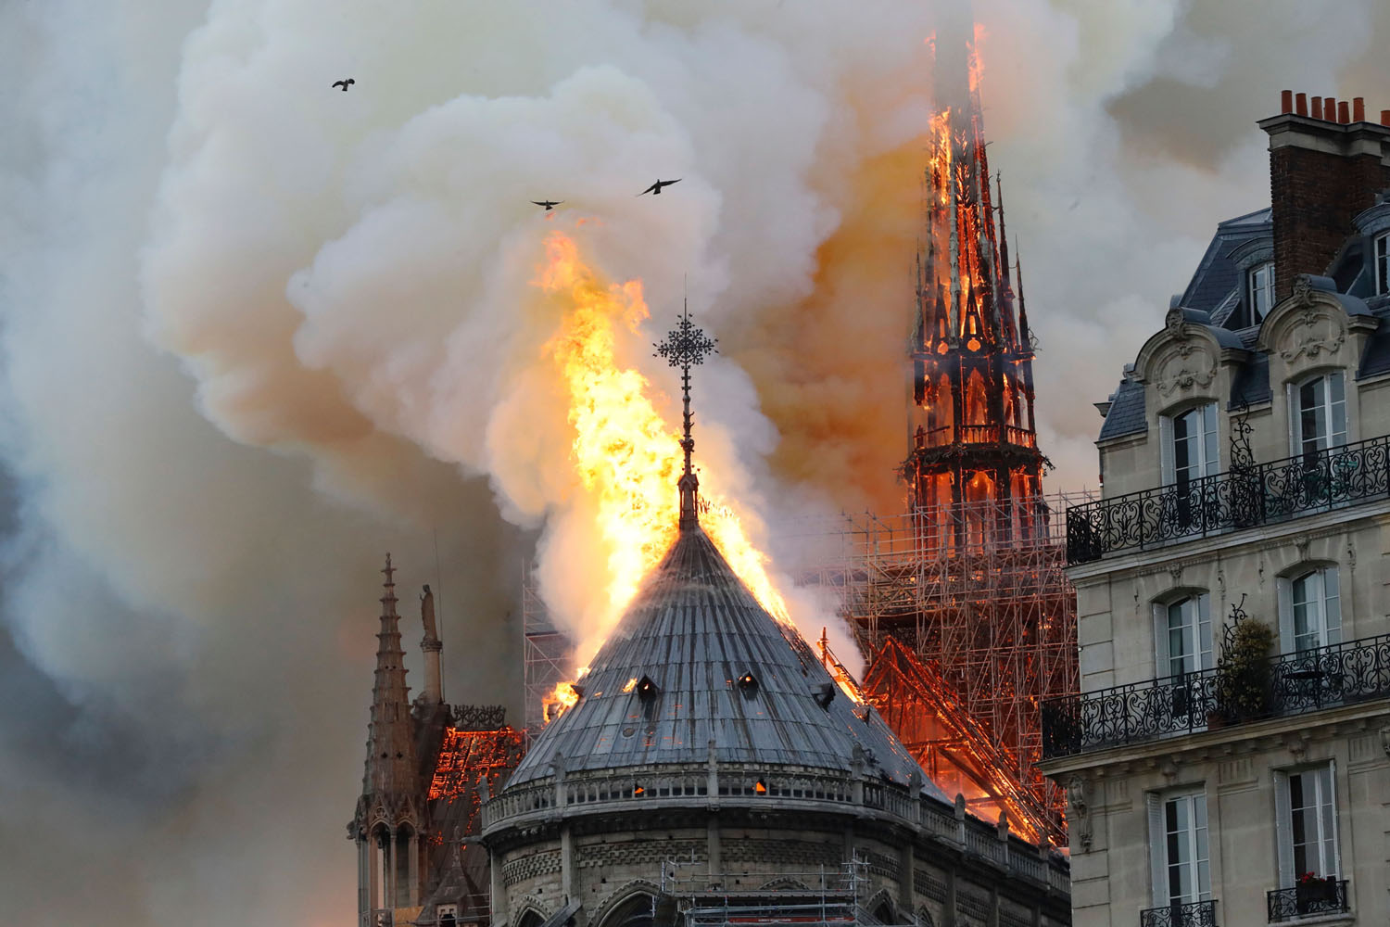

Slide 10
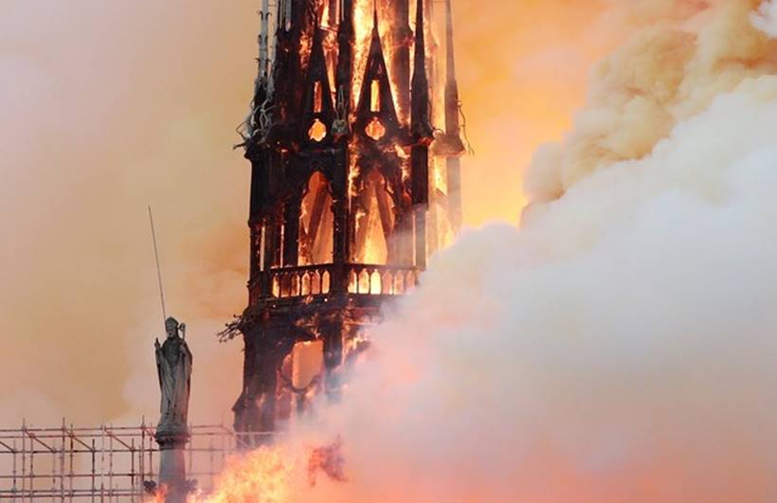

Slide 11
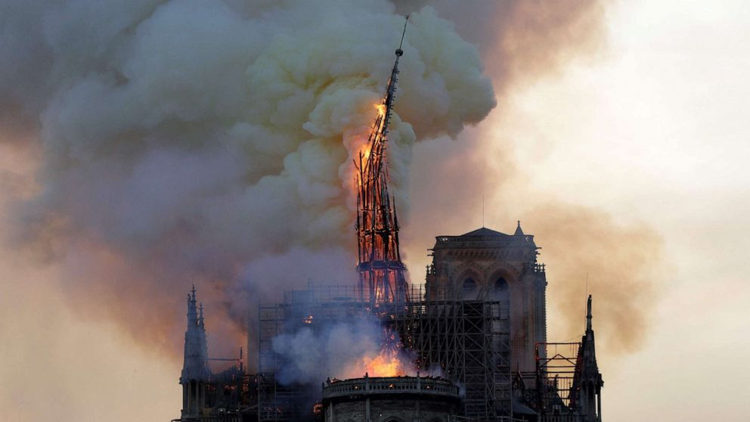

Slide 12
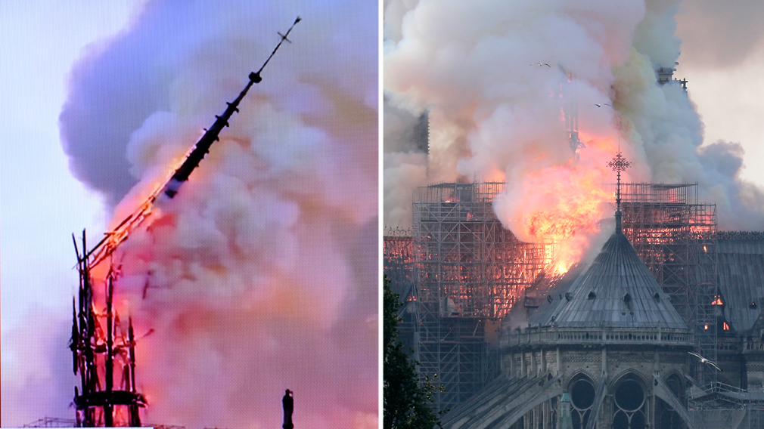

Slide 13
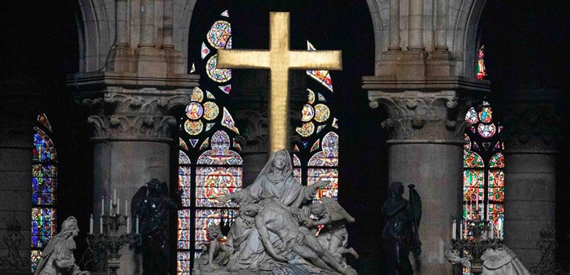

Slide 14
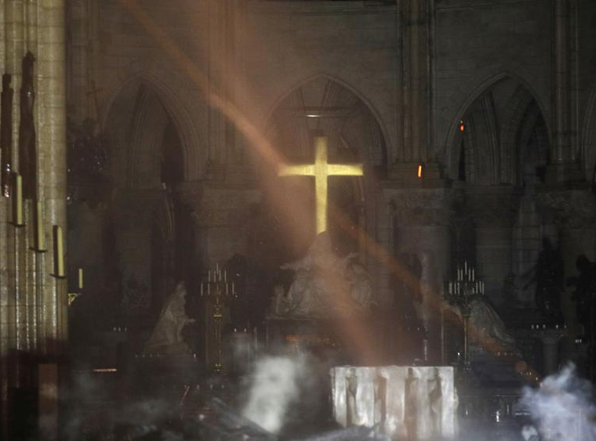

Slide 15
7 Proofs of the Resurrected Christ:
1. The “WORD” – (CHRIST) DECLARED it! (John 1:1-4, 14)

Slide 16
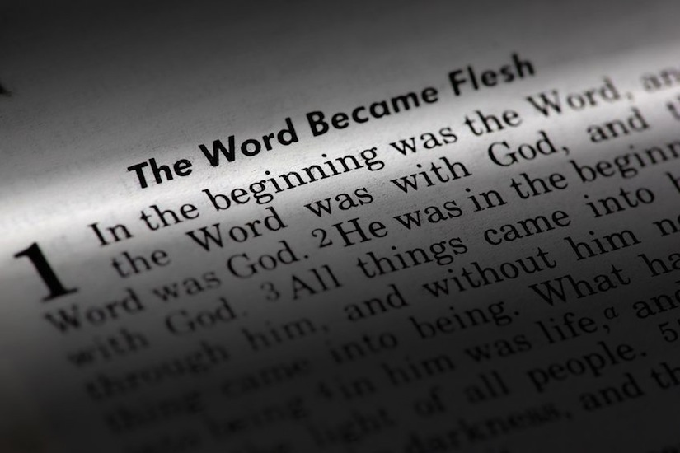

Slide 17
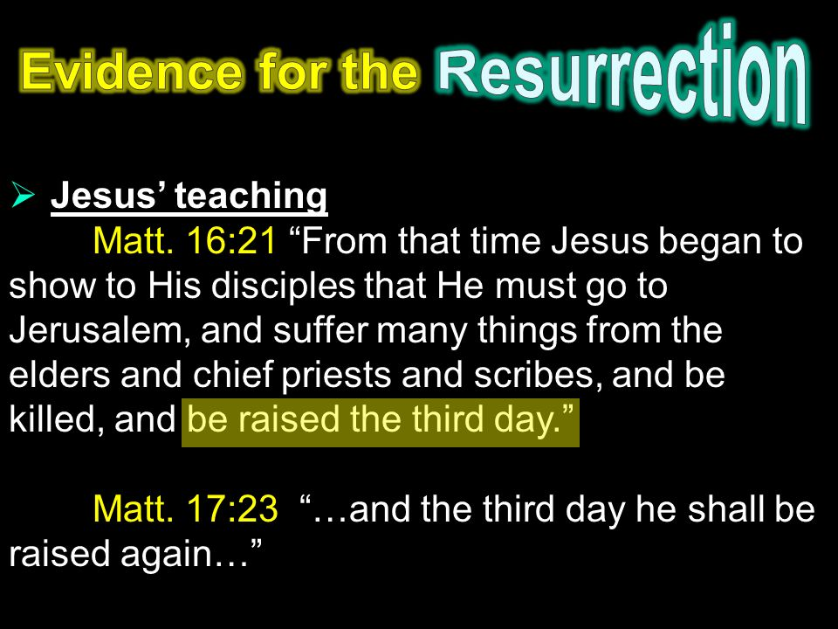

Slide 18
7 Proofs of the Resurrected Christ:
2. The “WOMEN” – DISCOVERED it! (Matthew 28:1-8; Luke 24:1-12)

Slide 19
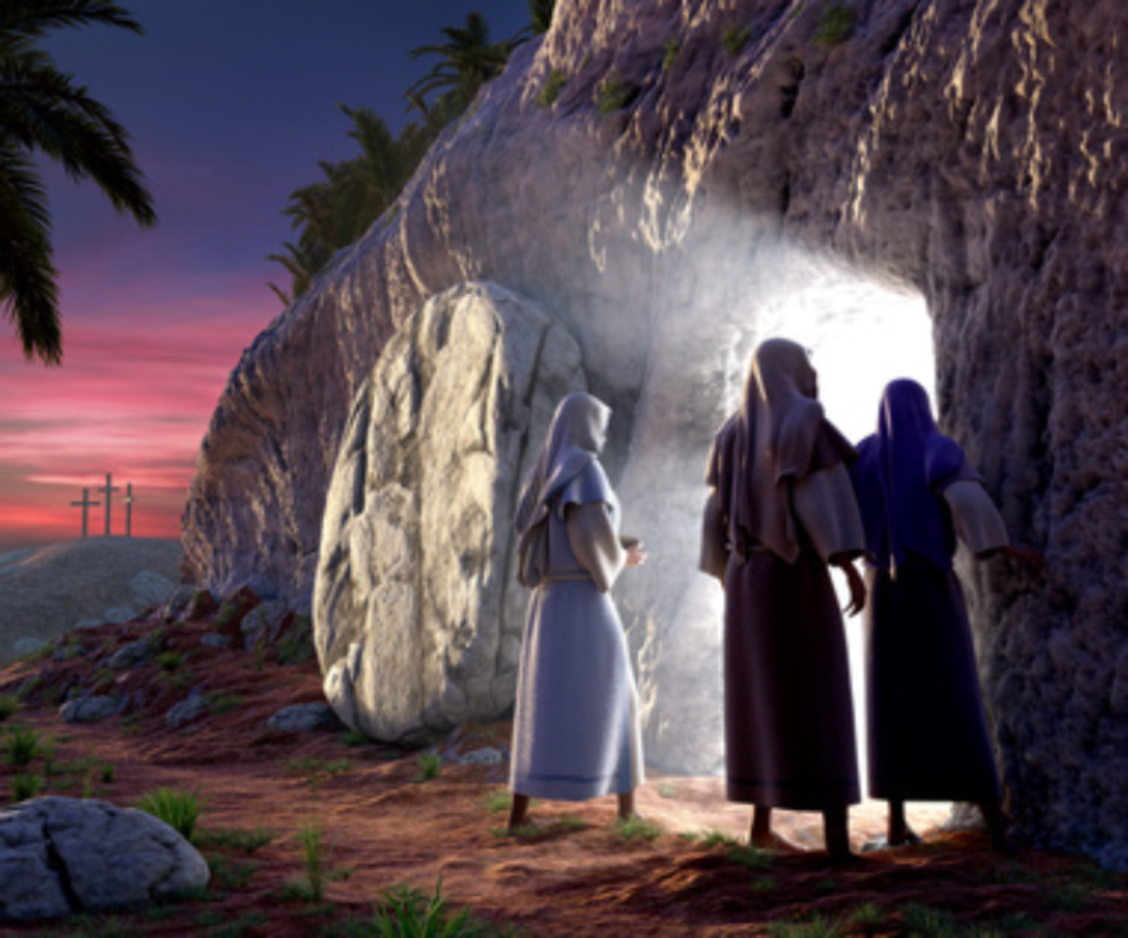

Slide 20
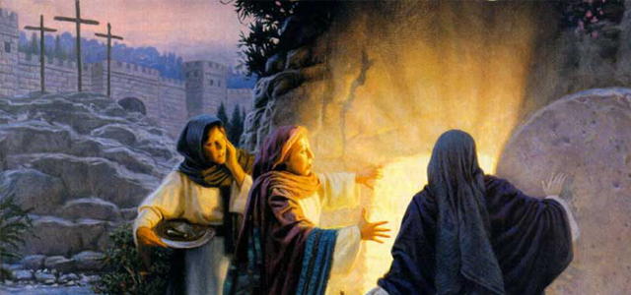

Slide 21
7 Proofs of the Resurrected Christ:
3. The “GUARDS” – DENIED it! (Matthew 28:3,11-15)

Slide 22
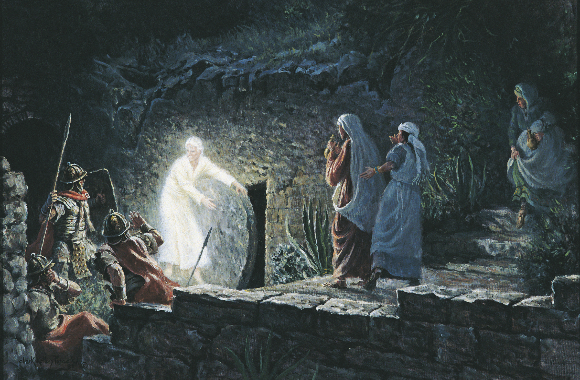

Slide 23
7 Proofs of the Resurrected Christ:
4. The “DISCIPLES” – Were MARTYRED for it! (Matthew 28:9.10)

Slide 24
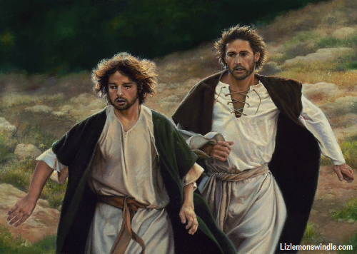

Slide 25
Behavior of Those Eyewitnesses
James, brother of John
  Beheaded by Herod
Philip
  Martyred in Greece
Andrew
  Bound to an X-Shaped Cross in Greece
Matthew
  Beheaded in Ethiopia

Slide 26
Behavior of Those Eyewitnesses
Peter
  Crucified upside down in Rome
Thomas
  Speared in India
Bartholemew
  Flayed alive in Armenia
Matthias
  Stoned and beheaded in Jerusalem

Slide 27
Behavior of Those Eyewitnesses
Thaddeus
  Crucified in Edessa, Greece
Simon
  Martyred in Persia
James, the brother of Jesus
  Thrown from the temple
Paul
  Beheaded by Nero in Rome

Slide 28
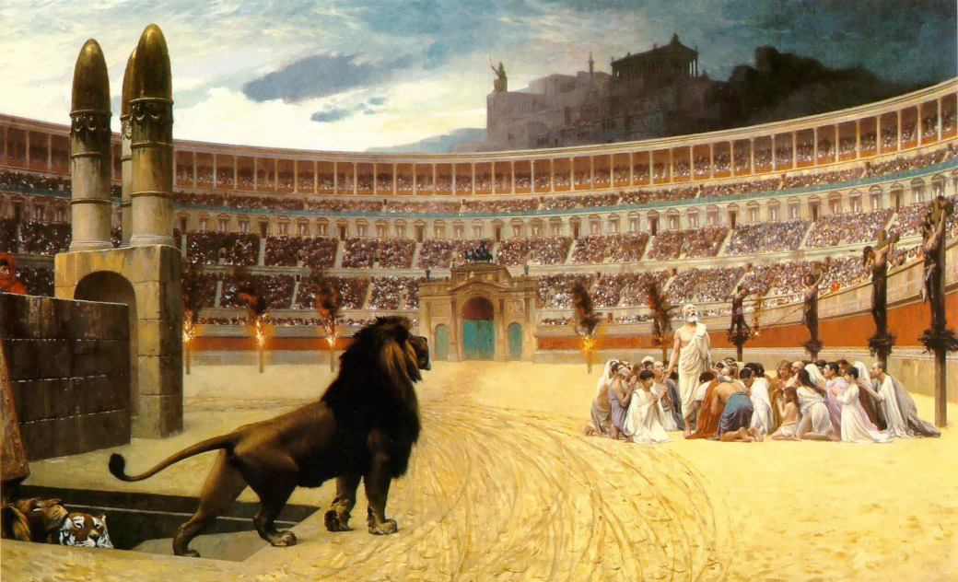

Slide 29
7 Proofs of the Resurrected Christ:
5. The “EVIDENCE:” the EMPTY TOMB – CONFIRMS it! (Matthew 27:51-56)

Slide 30
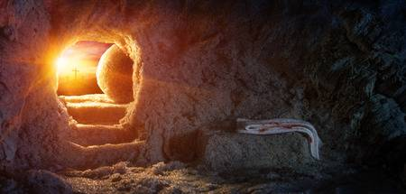
“He is not here! He is Risen, just as He said!”

Slide 31
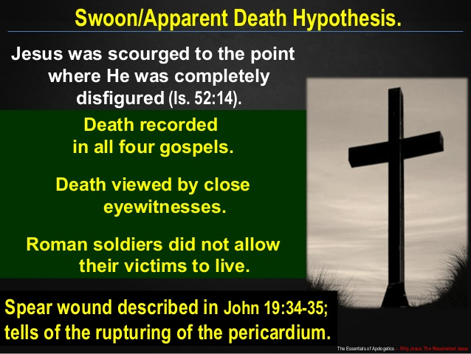

Slide 32
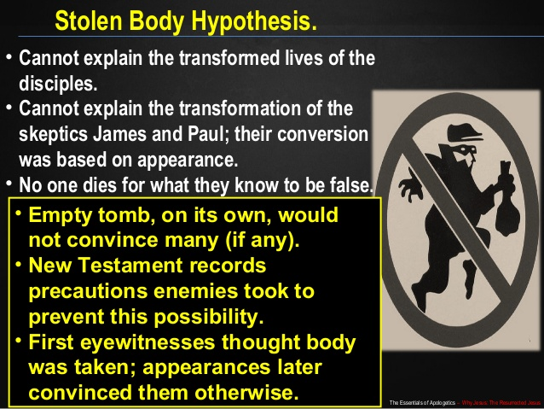

Slide 33
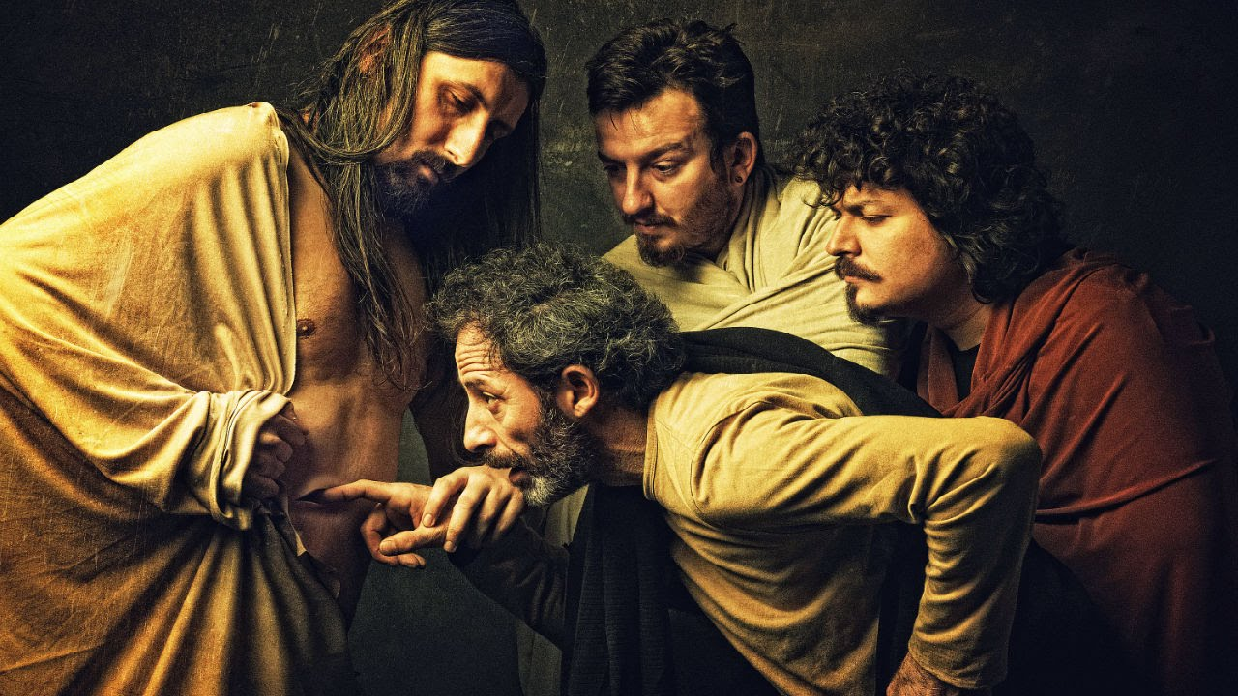
John 20:24-29

Slide 34
7 Proofs of the Resurrected Christ:
6. The “EYE-WITNESSES” – PROOVE it! (I Corinthians 15:5-11)

Slide 35
Mary Magdalene- Mark 16:9-11; John 20:10-18
The other women at the tomb- Matt. 28:8-10
Peter in Jerusalem – Lk. 24:34; 1 Cor. 15:5
The two travelers on the road - Mk. 16:12-13; Lk. 24:13-35
Ten disciples behind closed doors – Lk. 24:36-43; Jn. 20:19-25
All eleven disciples (including Thomas) – Mk. 16:14; Jn. 20:26-31; 1 Cor. 15:5
Seven disciples while fishing on the Sea of Galilee – Jn. 21:1-14
Eleven disciples on a mountain in Galilee – Mt. 28:16-20; Mk. 16:15-18
A crowd of 500 - 1 Cor. 15:6
Jesus' brother James - 1 Cor. 15:7
Those who watched Jesus ascend into heaven – Mk. 16:19-20; Lk. 24:50-53; Acts 1:3-9

Slide 36
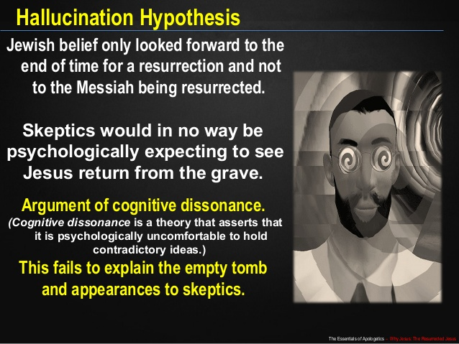

Slide 37
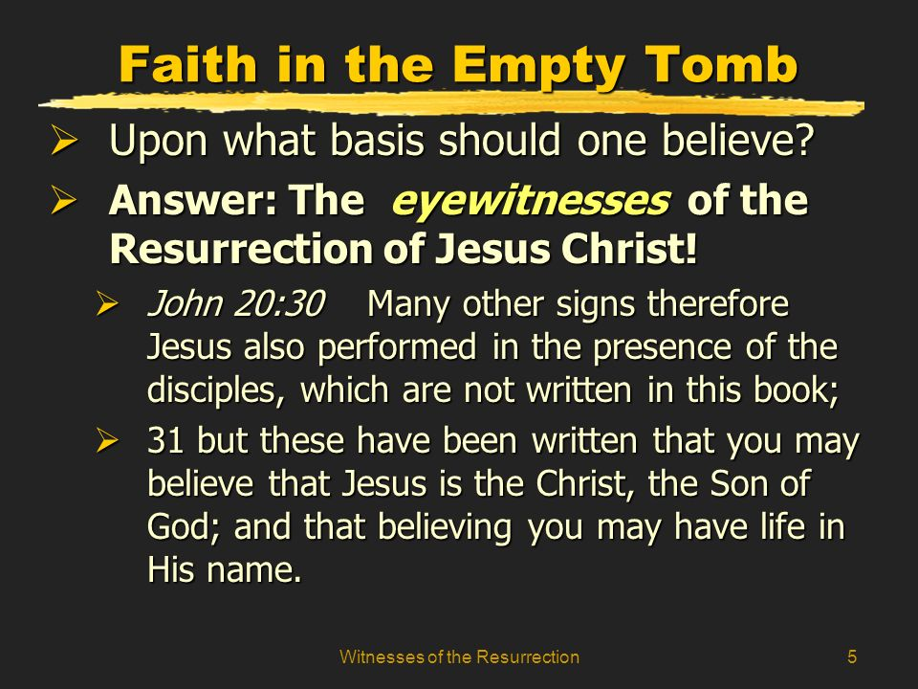

Slide 38
7 Proofs of the Resurrected Christ:
7. Our “FAITH - SALVATION” – REQUIRES it! (I Corinthians 15:12-19)

Slide 39
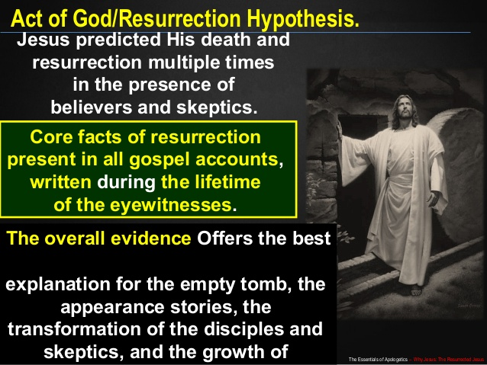

Slide 40


Slide 41
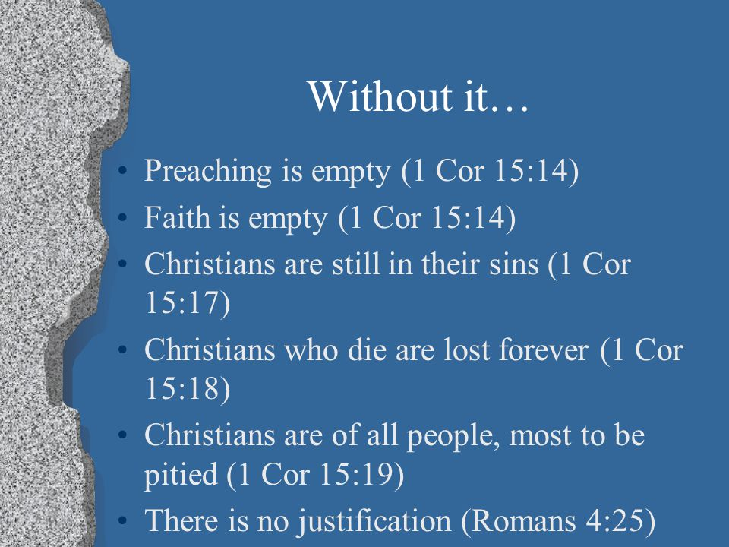

Slide 42
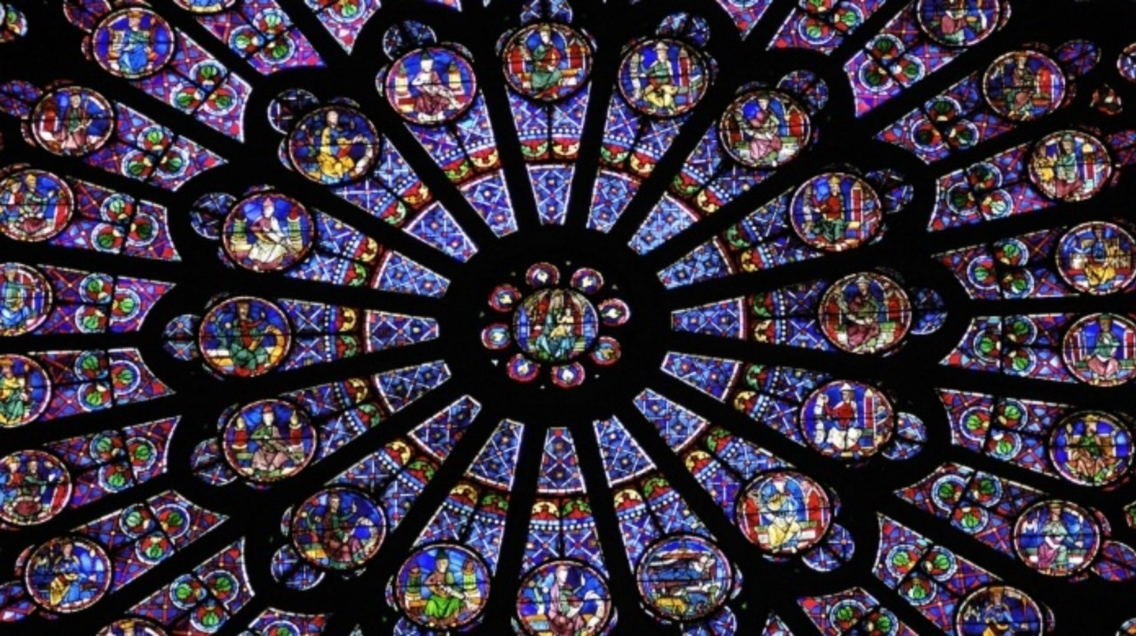

Slide 43
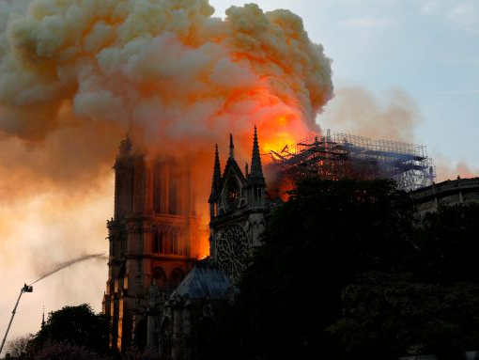
WE ARE THE CHURCH ON FIRE FOR CHRIST AND FOR HIS GOSPEL

Slide 44
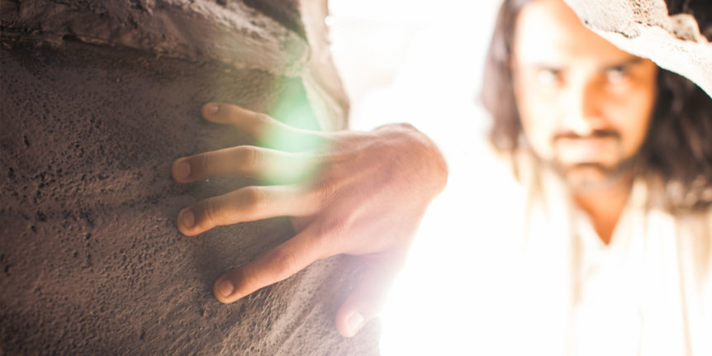
WHAT / WHO HAVE YOU PUT YOUR FAITH IN?

