Slide 2
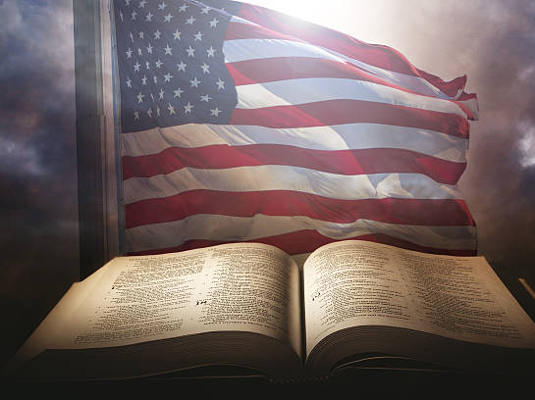
When Do We Submit to Human Government? (Unleashing the Power of the Gospel in America)
Romans 13:1-7

Slide 3
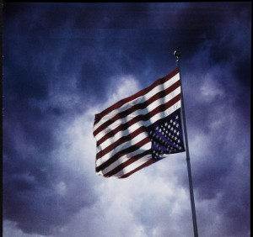
Is God Done With America?

Slide 4
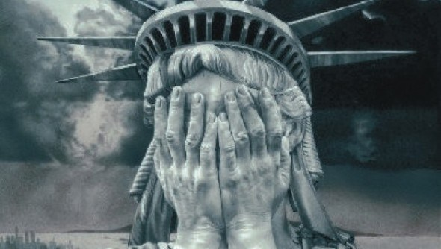
So Much Shame…

Slide 5
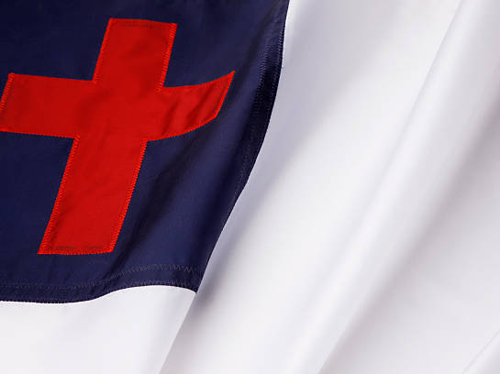
Pledge to the Christian Flag
I Pledge allegiance to the Christian Flag
And to the Savior: for Who’s Kingdom it stands,
One Savior: Crucified, Risen and Coming Again,
With Life and Liberty, for all who believe

Slide 6
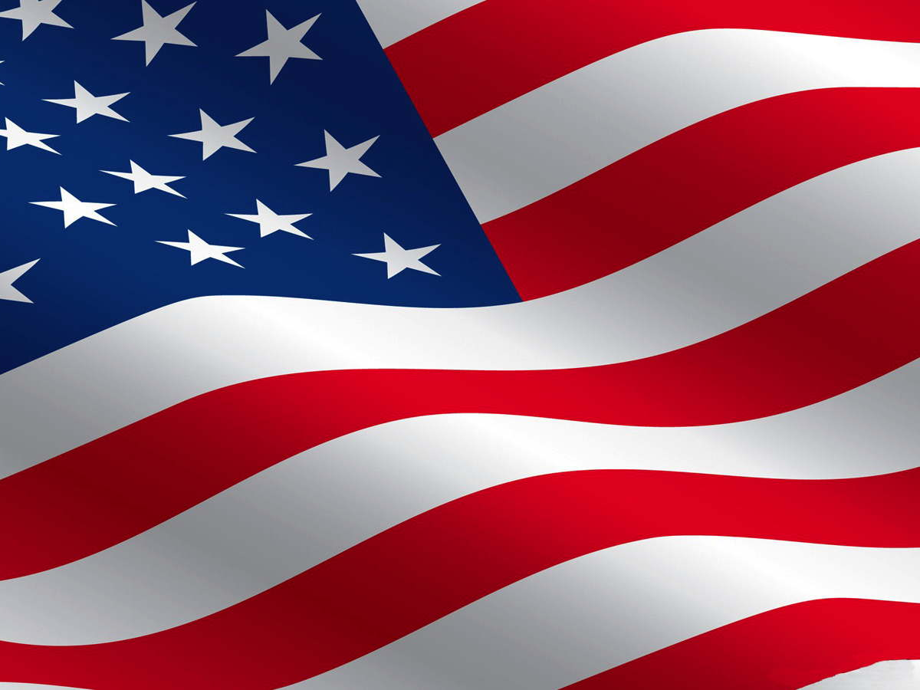
Pledge to the American Flag
I Pledge Allegiance to the flag of the United States of America and to the Republic, for which it stands, One Nation, Under God, Indivisible, with Liberty and Justice for ALL.

Slide 7
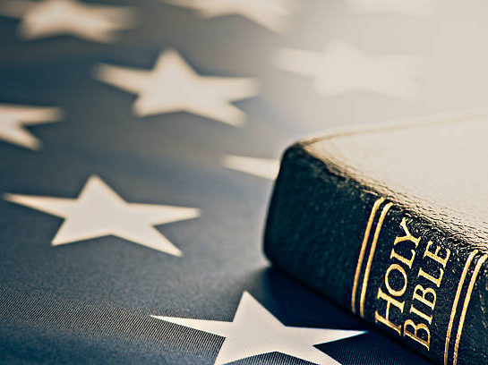
Pledge to the Bible
I Pledge Allegiance to the Bible, God’s Holy Word, I will make it a lamp unto my feet and a light unto my path, I will hide God’s Word in my heart, that I might not sin against Thee.

Slide 8

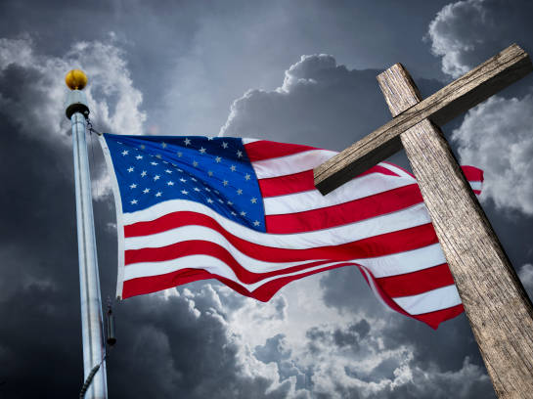
I. What About the Separation of Church and State?
The Error of the Term: “Separation of Church and State.”

Slide 9
Separation of Church and State:
The Term was Originally coined by Thomas Jefferson in a letter to the Danbury, Connecticut Baptists.
The metaphor was used exclusively to keep the state out of the church’s business, not to keep the church out of the state’s business.

Slide 10
Separation of Church and State:
Both the free exercise clause and the establishment clause place restrictions on the government concerning laws they pass or interfering with religion.
No restrictions are placed on religions except perhaps that a religious denomination cannot become the state religion.

Slide 11
Separation of Church and State:
The Establishment Clause states: “Congress shall make no law respecting an establishment of religion, or prohibiting the free exercise thereof.’
In 1892 the Supreme Court in the ‘Trinity Decision’ declared this country to be a ‘Christian Nation.’

Slide 12
Separation of Church and State:
John Quincy Adams said,
“The highest glory of the American Revolution was, it connected in one indissoluble bond, the principles of civil government with the principles of Christianity.”
90-95% of the founders were Trinitarian Christians.

Slide 13
America’s Roots as a ‘Christian Nation:” IN GOD WE TRUST.
Emblazoned over the Speaker of the House in the U.S. Capital are the words, “In God We Trust.”
The Supreme Court building built in the 1930’s has carvings of Moses and the Ten Commandments.
God is mentioned in stone all over Washington, D.C., on its monuments and buildings.

Slide 14
America’s Roots as a ‘Christian Nation:” IN GOD WE TRUST.
Oaths in Courtrooms all across America are used to invoke God and His Word, the Bible.
The founding fathers often quoted the Bible in their writings.
Every President that has given an inaugural address has given mention to the God of heaven.

Slide 15
America’s Roots as a ‘Christian Nation:” IN GOD WE TRUST.
Each President has given his oath of office on a copy of the Bible and has declared in his oath, ‘So help me, God!’
Prayers have been offered in the swearing in of every President.
Our national anthem mentions God.
In the original constitutions of every one of the 50 states mention God.

Slide 16
America’s Roots as a ‘Christian Nation:” IN GOD WE TRUST.
The Liberty Bell has a Bible verse inscribed on it: Leviticus 25:10 and it reads, "Proclaim liberty throughout all the land unto all inhabitants thereof."
Chaplains have been on the payroll from the very beginning.
Our nation’s Birth Certificate, the Declaration of Independence, mentions God four times.
The Word of God was used as our nation’s textbook in the public schools.

Slide 17
America’s Roots as a ‘Christian Nation:” IN GOD WE TRUST.
The Liberty Bell has a Bible verse inscribed on it: Leviticus 25:10 and it reads, "Proclaim liberty throughout all the land unto all inhabitants thereof."
Chaplains have been on the payroll from the very beginning.
Our nation’s Birth Certificate, the Declaration of Independence, mentions God four times.
The Word of God was used as our nation’s textbook in the public schools.

Slide 18
Is America a ‘Christian Nation?’
Is Christian teaching the primary religious system that influenced the founding of the United States? Yes or No? YES.
Were the majority of the Founding Fathers of the United States Christians who generally believed in the truth of the Bible? Yes or No? YES.

Slide 19
Is America a ‘Christian Nation?’
Is Christianity (of various sorts) the largest religion of the United States? YES.
Did Christian beliefs provide the intellectual background that lead to many of the cultural values still held by Americans today. YES.
Was there a Supreme Court Decision at one time that affirmed the U.S. is a Christian Nation? YES.

Slide 20
Is America a ‘Christian Nation?’
Are a majority of people in the United States Bible-believing, evangelical Christians? NO. 18-42%
Is belief in Christian values the dominant perspective promoted by the United States government, the media, and universities in the United States? NO.

Slide 21
Is America a ‘Christian Nation?’
Does the United States Government promote Christianity as the national religion? NO.
Does a person have to profess Christian faith in order to become a US Citizen or to have equal rights under the law in the Unites States? NO.

Slide 22
What Has Our Liberty Cost Us?
War of Independence: 4500 lives.
Civil War: 550,000 lives.
World War I: 116,000 lives.
World War II: 405,000 lives.
Korean War: 36,000 lives.
Vietnam War: 58,000 lives.
Iraq War: 4,000 lives.
Afghanistan War: 600+ lives.

Slide 23
ABRAHAM LINCOLN SAID…
At the end of his Gettysburg address:
“It is rather for us to be here dedicated to the great task remaining before us – that from these honored dead we take increased devotion to that cause for which they gave the last full measure of devotion – that we here highly resolve that these dead shall not have died in vain – that this nation, under God, shall have a new birth of freedom – and that a government of the people, by the people, and for the people, shall not perish from the earth.”

Slide 24
I. What About the Separation of Church and State?
The Error of the Term: “Separation of Church and State”
Understanding Jurisdictional Boundaries:

Slide 25
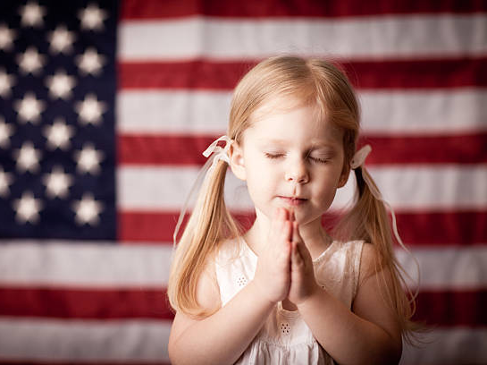
God Ordained Jurisdictions:
The Individual: Identity. Created in the Image of God.
Marriage: Intimacy. A Picture of Christ and His Bride – Church.
The Family: Society. An Illustration of the Family of God.
The Government: Safety / Security The Rule of Law - Law Keepers.
The Church: Community. A Picture of the Bride of Christ.

Slide 26
II. Where Does Human Government Begin?
1. God is Sovereign: He is the High King of Heaven and He Rules over all of the Universe. All Governments and people’s should bow before His majesty.
Romans 13:1

Slide 27
II. Where Does Human Government Begin?
2. God’s Word is to be Obeyed: The Government serves God. When we obey the laws of the land, we are obeying God Himself.
Romans 13:1b

Slide 28
III. Where Does Human Government Begin?
3. God is Our Ultimate Authority: The Government’s authority comes from God.
Romans 13:1,2

Slide 29
II. Where Does Human Government Begin?
4. God Wants All of Mankind to Submit to the Laws of the Land: We need not fear the government when we are obeying the just laws of the land.
Romans 13:3

Slide 30
II. Where Does Human Government Begin?
5. God is Just: The Government is God’s Minister to Promote Good and Restrain Evil.
Romans 13:4-7

Slide 31
5. God is Just:
God Alone is Our Sole Authority.
Caesar Alone is Our Authority.
God and Caesar is Our Authority Caesar having the dominant place.
God and Caesar is Our Authority God having the dominant place.

Slide 32
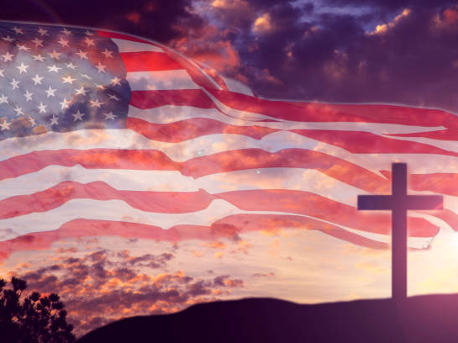
III. Where Does Human Government End?
When we no longer can preach the Gospel of Jesus Christ.
Matthew 28:18-20; 2:8-10; Acts 1:8; Acts 4:18-20; 5:29; Exodus 1:17,21; Esther 4:16; Daniel 3:13-30

Slide 33
III. Where Does Human Government End?
2. When we no longer can lead holy lives.
The Pilgrim’s came to America from Europe in search of religious freedom and liberty.
Were they wrong to seek their independence from Britain?

Slide 34
III. Where Does Human Government End?
3. When we no longer can teach or lead our children.
4. When we no longer can worship in religious freedom.
5. When we no longer can follow our conscience.

Slide 35
III. Where Does Human Government End?
6. When innocent life is threatened.
7. When government no longer guards and protects human liberty.

Slide 36
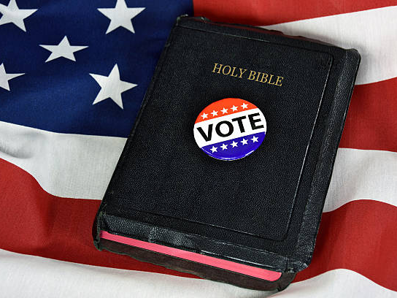
What’s the Difference Between a Democracy and a Republic?
The main difference between a Democracy and a Republic is the extent to which the people control the process of making laws under each form of government.

Slide 37
What’s the Difference Between a Democracy and a Republic?
In a Democracy the voting majority has almost unlimited power to make laws. – The Popular Vote.
In a Republic the people elect representatives to make laws according to the constraints of a Constitution. – The Electoral College.

Slide 38
IV. What Does it Mean to Live in a Constitutional Republic?
We the People… (VOTE)
We the People live holy lives according to the principles of God’s Holy Word. (VOTE TRUTH)

Slide 39
IV. What Does it Mean to Live in a Constitutional Republic?
We the People protect Life, Liberty and the Pursuit of Happiness… (VOTE GODLY)
We the People Protect the Balance of Power: (VOTE RIGHTEOUSLY)
We the People Give Honor. Romans 13:7b (VOTE RESPECTFULLY)

Slide 40
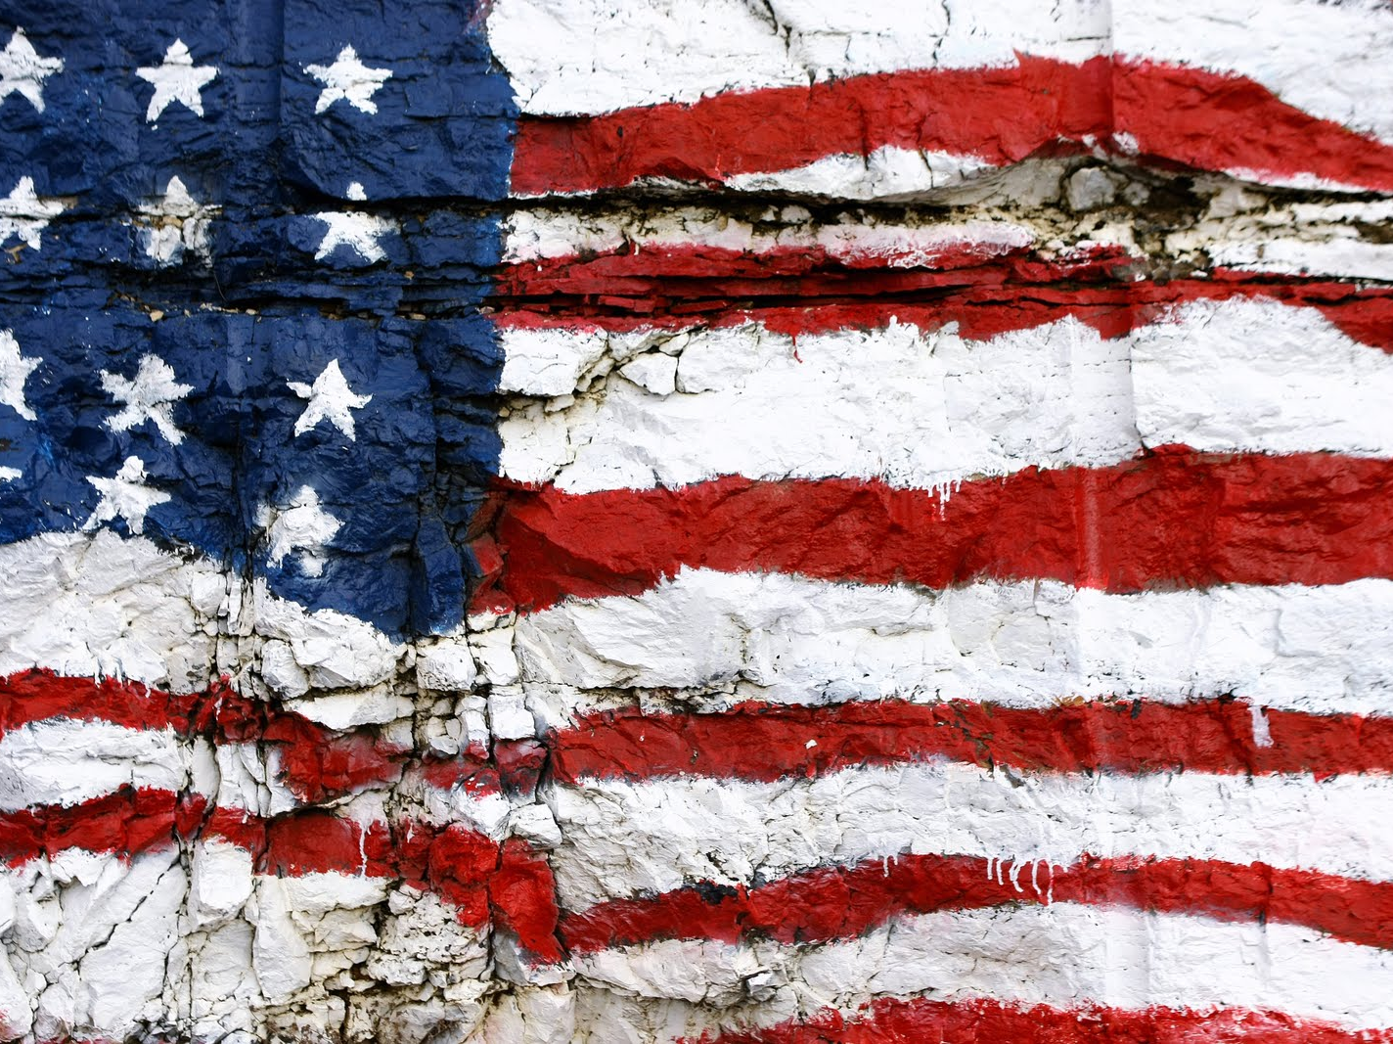
America the Beautiful
O beautiful for spacious skies, for amber waves of grain
For purple mountain majesties, above the fruited plain
America, America, God shed His grace on thee
And crown thy good with brotherhood, from sea to shining sea

Slide 41
America the Beautiful
O beautiful for Pilgrim feet, whose stern impassioned stress
A thoroughfare for freedom beat, across the wilderness
America, America, God mend thine every flaw
Confirm thy soul in self control, Thy liberty in law

Slide 42
America the Beautiful
O beautiful for heroes proved, in liberating strife
Who more than self their country loved, and mercy more than life
America, America, May God they gold refine
Till all success be nobleness, and every gain divine

Slide 43
America the Beautiful
O beautiful for patriot dream, that sees beyond the years
Thine alabaster cities gleam, undimmed by human tears
America, America, God shed His grace on thee
And crown thy good with brotherhood, from sea to shining sea

