Slide 1
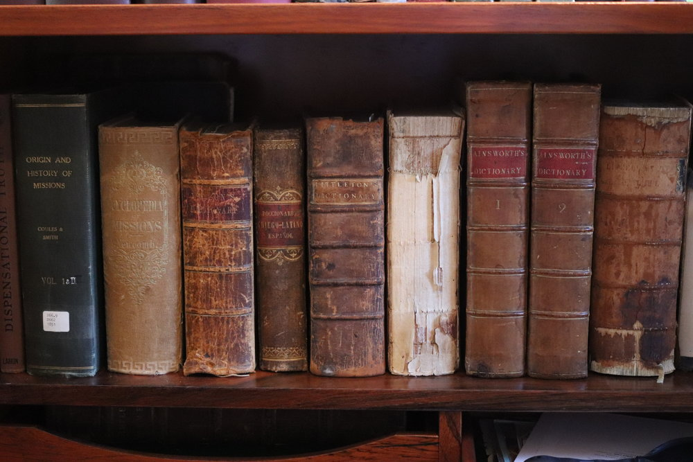
Can We Trust Our Bibles?
“The Word of God”
(The Doctrines of Incarnation and Bible Translations)

Slide 2

Money.
Words change / definitions change.
New MSS discovered.
New insight into old languages.

Slide 3
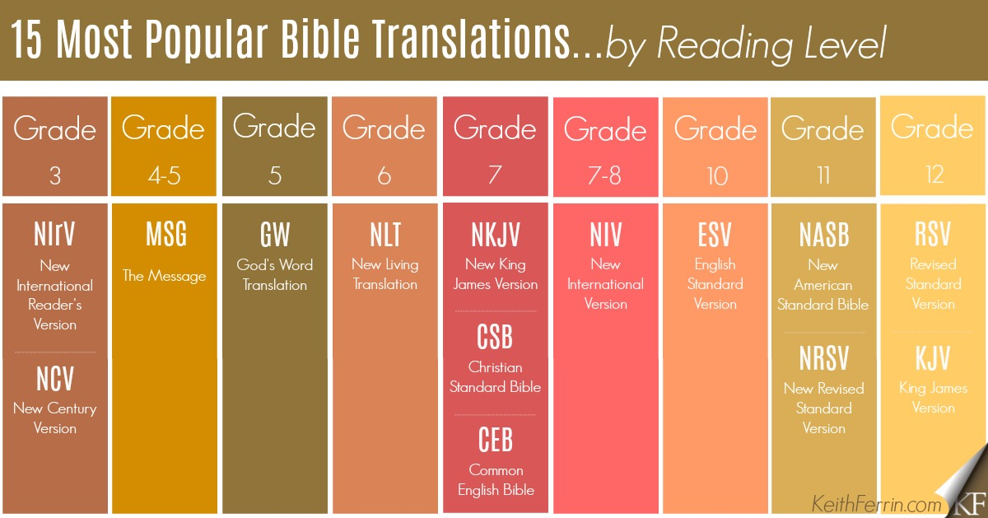

Slide 4
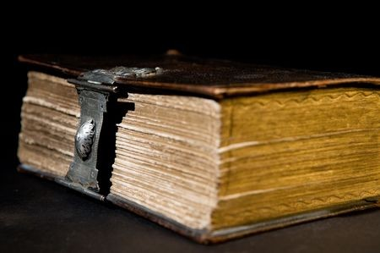
“The Word of God”
1. The Doctrine of Bible Translations.

Slide 5
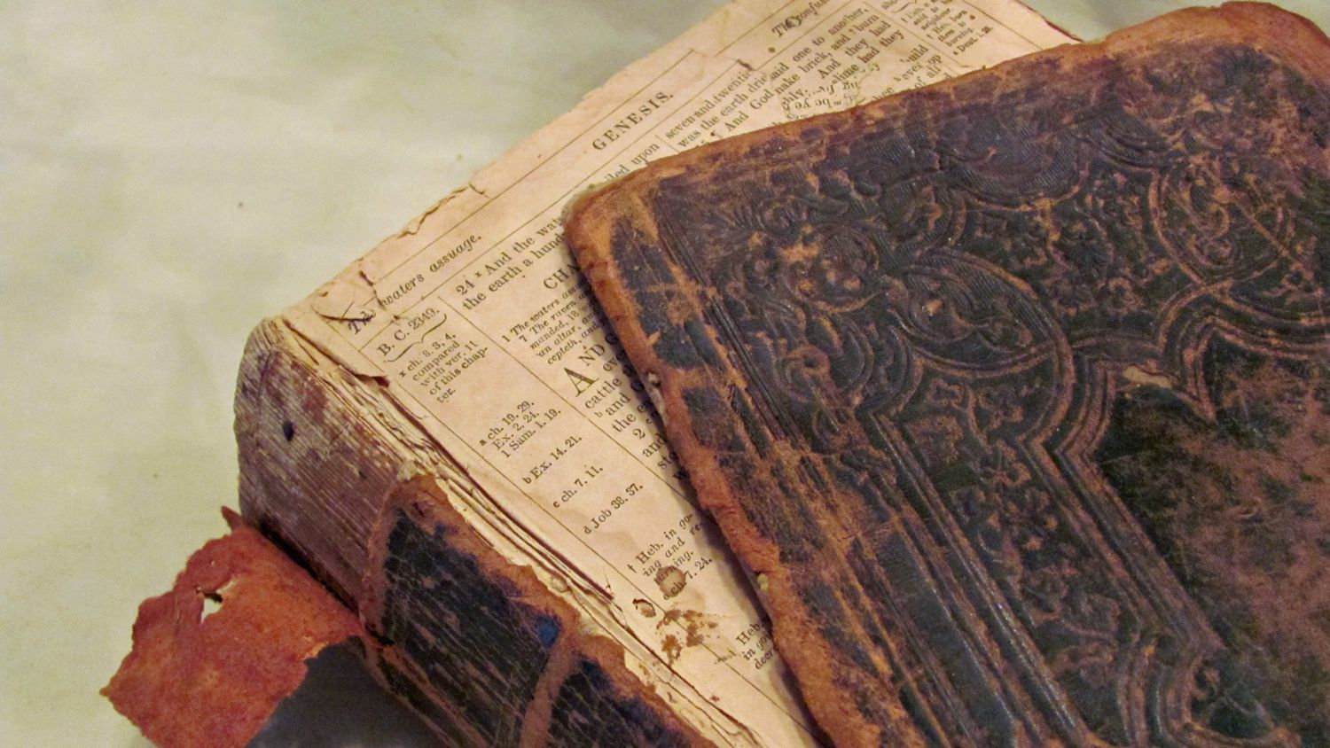
“The Word of God”
The Doctrine of Bible Translations.
Has God’s Word been faithfully preserved down through the centuries?
Psalm 126:6,7
Matthew 24:35

Slide 6

“The Word of God”
The Doctrine of Bible Translations.
Submit your thinking to the Word of God; rather than the Word of God to your thinking.

Slide 7
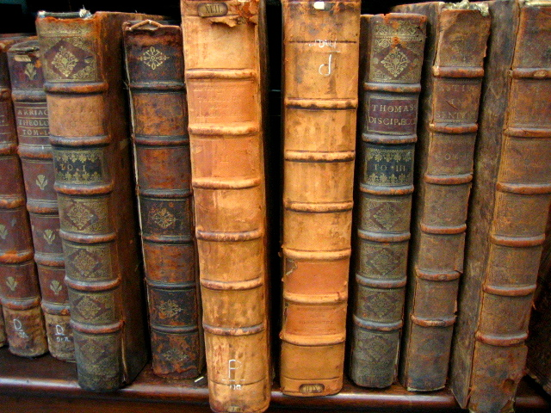
“The Word of God”
The Doctrine of Bible Translations.
What ancient manuscripts (MSS) can be trusted to ensure the validity and integrity of preserved Scripture?

Slide 8
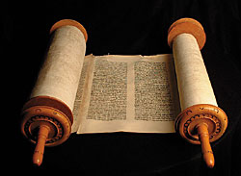
“The Word of God”
The Doctrine of Bible Translations.
The Best Documents:
Hebrew
Aramaic
Greek
Latin
English?

Slide 9
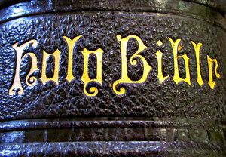
“The Word of God”
How do we know that the best MSS copies we have are accurate from the original MSS?
The Old and New Testament documents are the most attested of all the earliest MSS without a doubt they validate the integrity of the Scriptures.

Slide 10
“The Word of God”
How do we know that the best MSS copies we have are accurate from the original MSS?
The gap of time between the original autographs and our earliest MSS is earlier than any other secular MSS under consideration, such as Homer’s illiad, Ceasar’s Gallic wars or any author who wrote previous to the first century.

Slide 11
“The Word of God”
How do we know that the best MSS copies we have are accurate from the original MSS?
The original text of the Scriptures can be rendered as 99% certain. Scholars are sure they know what the Biblical authors wrote due to the number of the earlier MSS.

Slide 12
“The Word of God”
How do we know that the best MSS copies we have are accurate from the original MSS?
The minor grammatical, wording differences between all the MSS copies do not change or call into question any theology.

Slide 13
“The Word of God”
How do we know that the best MSS copies we have are accurate from the original MSS?
The Gospel of Jesus Christ is clearly presented in all the Greek MSS.
Robert G. Gromacki

Slide 14
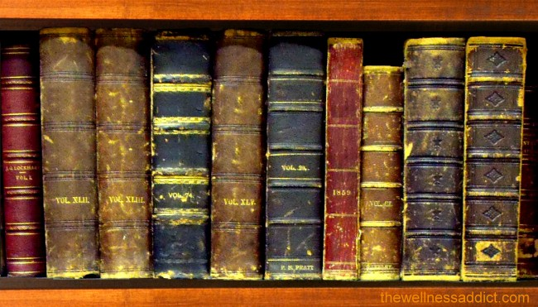
“The Word of God”
The Doctrine of Bible Translations.
What’s the difference between Word for word (Formal Equivalence) and Thought for thought (Dynamic Equivalence) translations?

Slide 15
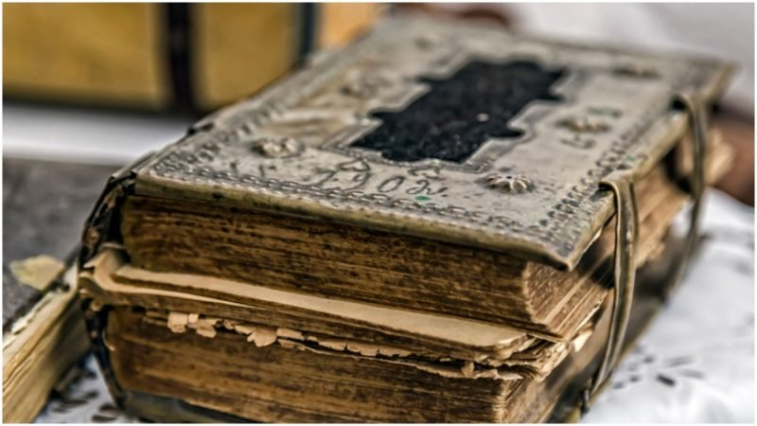
WHAT’S THE DIFFERENCE?:
A LOW VIEW OF MAN.
A HIGH VIEW OF GOD.

Slide 16
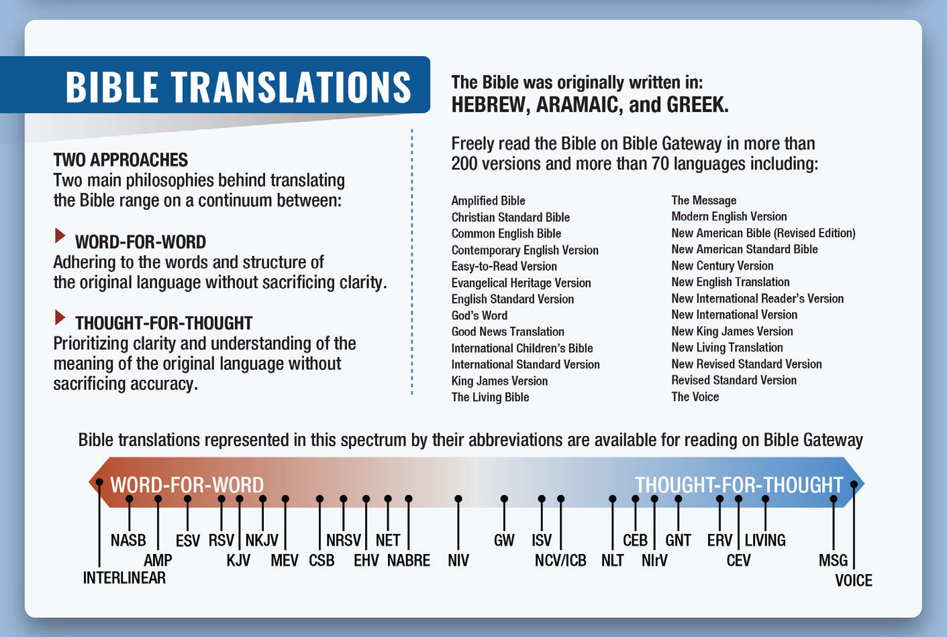

Slide 17
WHAT’S THE DIFFERENCE?:
Word for Word (Formal Equivalence).
Thought for Thought (Dynamic Equivalence).

Slide 18
WHAT’S THE DIFFERENCE?:
D.E. believes it is the duty of the translator to make interpretative decisions for the ignorant reader.
Biblical metaphors are difficult to understand so the translator takes the liberty to illuminate the metaphor.

Slide 19
WHAT’S THE DIFFERENCE?:
Many words have little meaning to the reader so more words are used to simplify the intent so the reader can more easily understand.

Slide 20
WHAT’S THE DIFFERENCE?:
Ancient customs are often unfamiliar to modern readers.
Figurative language is replaced with literal statements easier to understand.

Slide 21
WHAT’S THE DIFFERENCE?:
Translators change words that have gone out of use and are no longer used in todays speech.
Translators change what the authors wrote to suggest what the authors meant.

Slide 22
WHAT’S THE DIFFERENCE?:
Gender references are changed to reflect a more sensitive and mature cultural sensitivity.
Make the more wordy sentences shorter and more precise.

Slide 23
WHAT’S THE DIFFERENCE?:
D.E. translators willingly trade the reliability of the Word for word text for the readability thought for thought text.

Slide 24
WHAT’S THE DIFFERENCE?:
D.E. translators have traded the very and every word of God for their interpretation of what they think it says and essentially have removed the work of the Holy Spirit as the Illuminator of His Word.

Slide 25
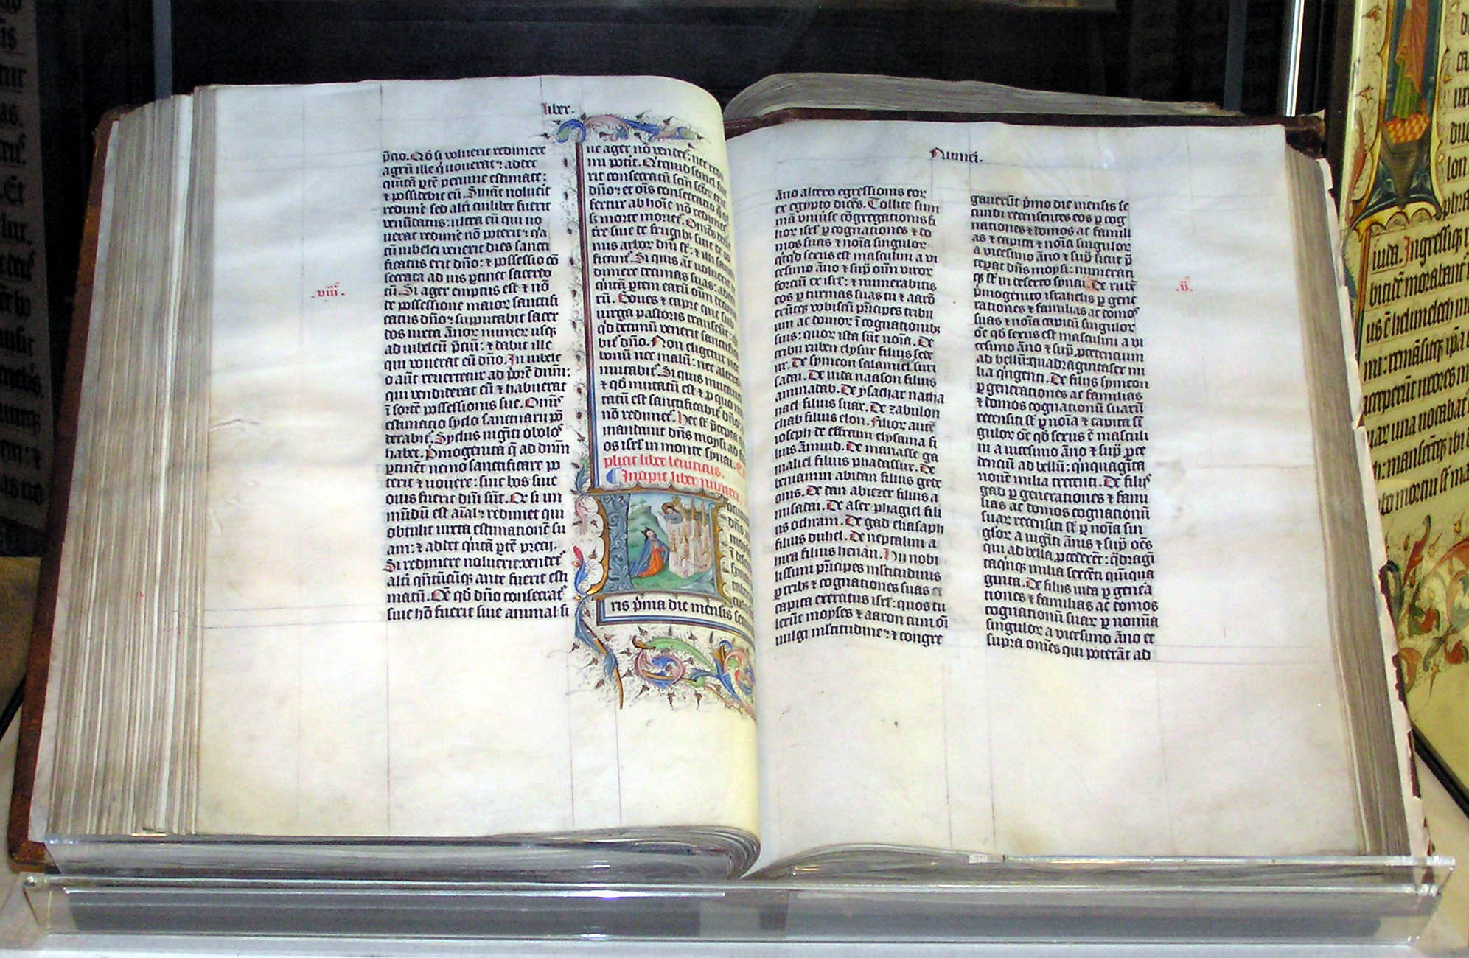
“The Word of God”
The Doctrine of Bible Translations.
Ten Reasons for trusting our English, Word for word translations of God’s Word.

Slide 26
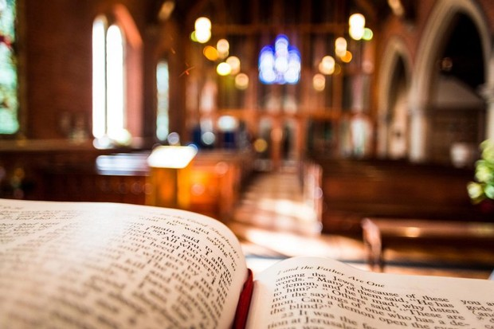
Word for word Translations:
Faithfulness to the original MSS.
Keeping the essential task of translation paramount.
Not mixing personal commentary with the translation.

Slide 27
Word for word Translations:
4. Preserving theological precision with the tradition.
5. Not needing to correct the translation when preaching.
6. Preserving what the Biblical writers actually wrote.

Slide 28
Word for word Translations:
7. Preserving the literary quality and beauty of the Bible.
8. Submitting the culture to the words of Scripture instead of submitting the words of Scripture to the cultural erosion of Biblical words.

Slide 29
Word for word Translations:
9. Choose your Bible wisely knowing the lives of godly, holy men of the Reformation were given so you could own a reliable Bible version.

Slide 30
Word for word Translations:
10. Respect the Word of God as the very breath of God. Don’t insult the Holy Spirit by a reckless spirit of indifference.

Slide 31
“The Word of God”
2. The Doctrine of Incarnation.

Slide 32
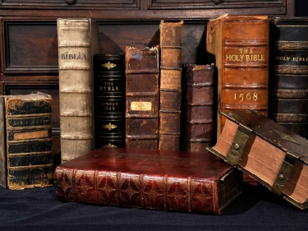
“The Word of God”
2. The Doctrine of Incarnation.
The Deity of Jesus Christ. John 1:1,2

Slide 33
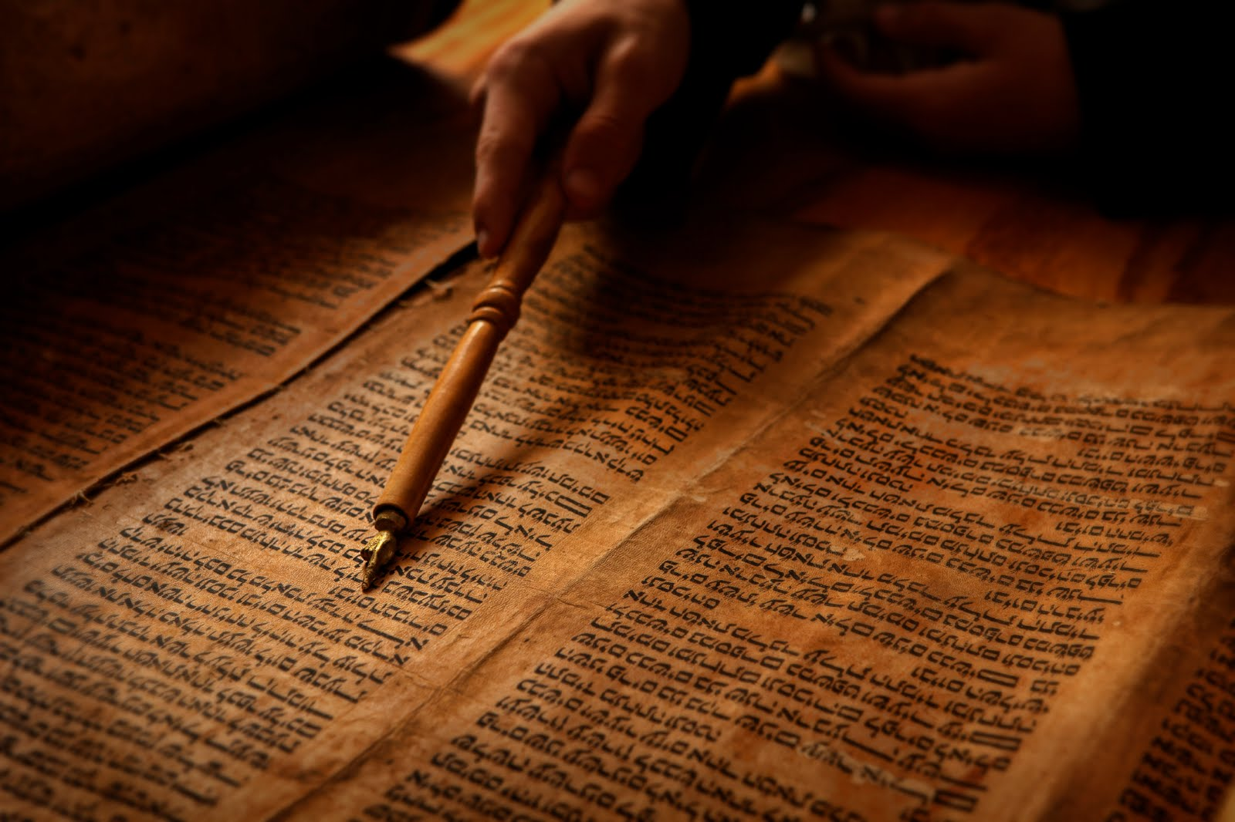
“The Word of God”
In the beginning was the Word, and the Word was with God and the Word was God.
John 1:1 NKJV

Slide 34
“The Word of God”
He was in the beginning with God.
John 1:2 NKJV

Slide 35
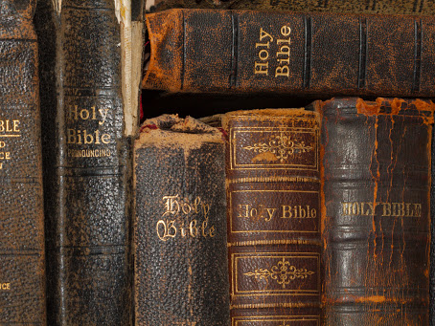
“The Word of God”
2. The Doctrine of Incarnation.
The Preincarnation of Jesus Christ. John 1:3-5

Slide 36
“The Word of God”
All things were made through Him, and without Him nothing was made that was made..
John 1:3 NKJV

Slide 37
“The Word of God”
In Him was life, the life was the light of men.
John 1:4 NKJV

Slide 38
“The Word of God”
And the light shines in the darkness, and the darkness did not not comprehend it.
John 1:5 NKJV

Slide 39
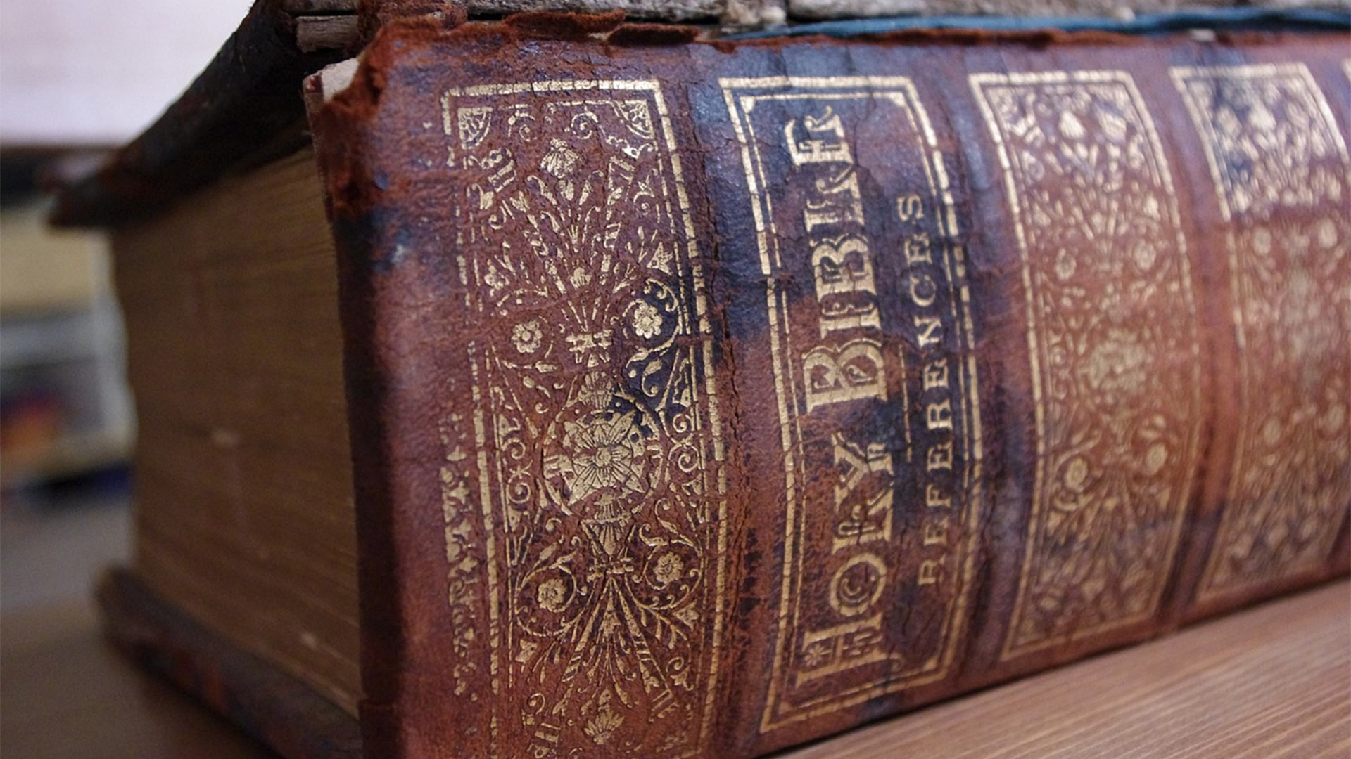
“The Word of God”
2. The Doctrine of Incarnation.
The Forerunner of Jesus Christ. John 1:6-8

Slide 40
“The Word of God”
There was a man sent from God, whose name was John.
John 1:6 NKJV

Slide 41
“The Word of God”
This man came for a witness, to bear witness of the Light, but was sent to bear witness of that Light.
John 1:7 NKJV

Slide 42
“The Word of God”
He was not that Light, but was sent to bear witness of that Light.
John 1:8 NKJV

Slide 43

“The Word of God”
2. The Doctrine of Incarnation.
The Rejection of Jesus Christ. John 1:9-11

Slide 44
“The Word of God”
That was the true Light which gives light to every man who comes into the world..
John 1:9 NKJV

Slide 45
“The Word of God”
He was in the world, and the world was made through Him, and the world did not know Him.
John 1:10 NKJV

Slide 46
“The Word of God”
He came to His own, and His own did not receive Him.
John 1:11 NKJV

Slide 47

“The Word of God”
2. The Doctrine of Incarnation.
The Acceptance of Jesus Christ. John 1:12-13

Slide 48
“The Word of God”
But as many as received Him, to them He gave the right to become the children of God, to those who believe in His name.
John 1:12 NKJV

Slide 49
“The Word of God”
Who were born, not of blood, nor of the will of the flesh, nor of the will of man, but of God.
John 1:13 NKJV

Slide 50
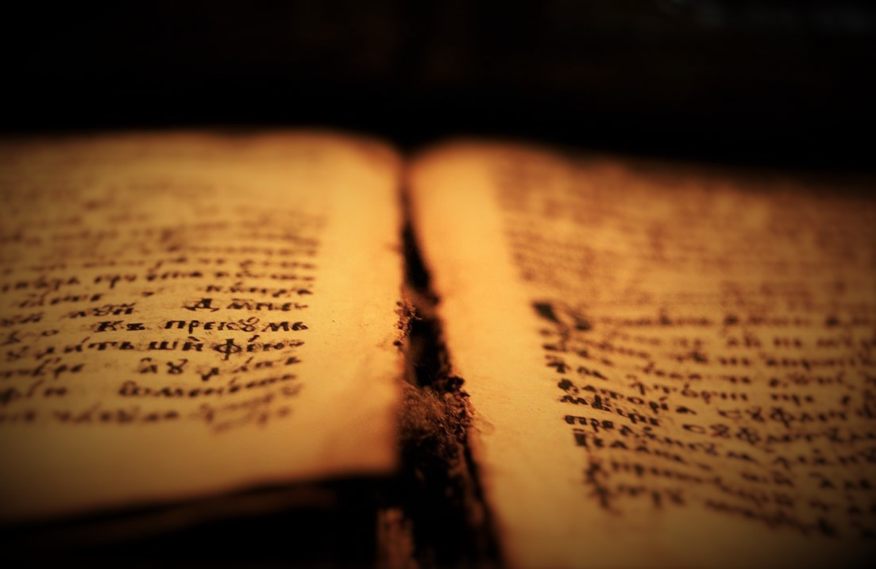
“The Word of God”
2. The Doctrine of Incarnation.
The Incarnation of Jesus Christ. John 1:14-18

Slide 51
“The Word of God”
And the Word became flesh and dwelt among us, and we beheld His glory, the glory as of the only begotten of the Father, full of grace and truth.
John 1:14 NKJV

Slide 52
“The Word of God”
John bore witness of Him and cried out saying, ‘This was He of whom I said, ‘He who comes after me is preferred before me, for He was before me.’”
John 1:15 NKJV

Slide 53
“The Word of God”
And of His fullness we have all received, and grace for grace.
John 1:16 NKJV

Slide 54
“The Word of God”
For the law was given through Moses, but grace and truth came through Jesus Christ.
John 1:17 NKJV

Slide 55
“The Word of God”
No one has seen God at any time. The only begotten Son, who is in the bosom of the Father, He has declared Him.
John 1:18 NKJV

Slide 56

Take it Home / Moment of Decision:

